Slide 1
Managing risk
through Derivatives

Slide 2
Agenda
Developments
Group NCDEX
NERL the Repository
Options
Soybean @ NCDEX
Price Risk
Risk Mitigation

Slide 3
Steps for market development
SEBI taking over as the Regulator
Reintroduction of delisted commodities
Introduction of Options
Establishment of Repositories
Increase in position limits (In Soybean client level position limits increased from 60,000 to 1,40,000 MT)
Permitting new category of participants – Cat III AIFs
Spot future integration

Slide 4
Not for profit institution for Education and Research
NICR
E-auctions, Spot markets and Unified Market Platform
NCDEX Group
NERL
NeML
A centralized repository for WDRA
ReMS
Karnataka State Agricultural Market
Equal Joint Venture Company of NeML with Govt. of Karnataka
NCCL
Clearing & Settlement house

Slide 5
NERL - Market for warehouse receipt finance
No of Active Financial Institutions
(WR business)
75
Rs. 1.66 lakh crores
Total Farmer Producer Companies
4,000
Rs. 9 lakh crores
Rs. 35,000 crores
Total No. of Primary Agriculture Co-operative societies
93,000
Total Primary Agri lending
Total no. of bank branches
102,343
Potential Warehouse Receipt Financing Business *
Actual Warehouse Receipt Financing Business
*NABCONS
7

Slide 6
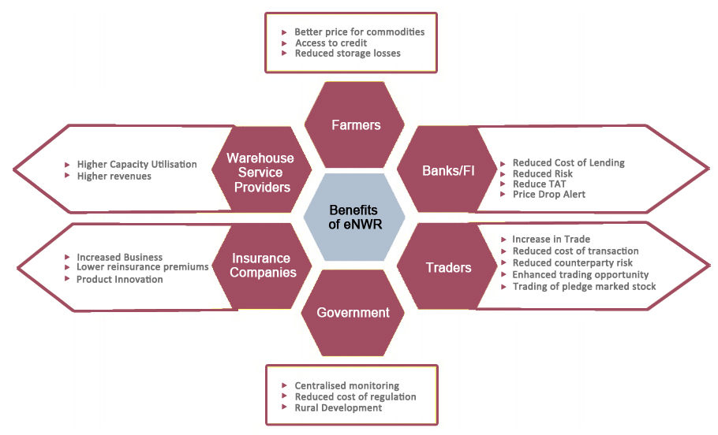
NERL - Benefits of e-NWR

Slide 7
Options - Key Features
SEBI has permitted European Options with commodity futures as underlying
One contract per exchange would be allowed (Guar Seed for NCDEX)
Underlying futures will be among the top five futures contract for the exchange.
On expiration, if exercised, In the Money (ITM) Option contract to Devolve in underlying Futures Contract.
long call position shall devolve into long position in the underlying futures contract
long put position shall devolve into short position in the underlying futures contract
short call position shall devolve into short position in the underlying futures contract
short put position shall devolve into long position in the underlying futures contract
Position limits of options would be separate from position limits of futures contracts.
Numerical value for client level/member level position limits shall be twice of corresponding numbers applicable for futures contracts.

Slide 8
Options - Advantages over Futures
Limited downside risk for Option Buyer.
Buyer need to pay only premium hence No Mark to Market (MTM) and Margins to be paid.
Higher leveraging.
Commodity transaction Tax (CTT) and Transaction charges to be levied only on premium, hence lesser cost of transaction.
Trading possible even without taking a price view in the market (Volatility trading).
An option buyer can not only manage his risk but also capture the favorable price movement

Slide 9
Soybean @ NCDEX
15-Dec-03 trading commenced
Oct-05
Made two contracts Soybean A and B
Jan-10 Sellers option to Compulsory delivery
Oct-14
Added Latur as ADC
July-10 Compulsory delivery to Sellers option
Oct-12
Added Vidisha & Mandsaur as ADC.
Fresh positions in last 5 days prior to expiry
Mar-16 Removed Itarsi as ADC
Nov-16 Merged Soybean A & B to one contract. Added Shujalpur as ADC
Oct-16 Made all delivery centers at par with Indore
Feb-15 Alternate contracts in Soybean B
Feb-16 Continuous contracts in Soybean B
Aug-17 Launched Aug-17 contract

Slide 10
Soybean @ NCDEX

Slide 11
Soybean @ NCDEX

Slide 12
Soybean @ NCDEX
Handled record deposits approx. (2.5 lakh MT) of Soybean at all the nine delivery centers in last season
There were no quality issues while lifting
Buyers appreciated the availability and quality of Soybeans
We have widened our product offering by adding three new futures contract this year
Soybean Meal
Rapeseed Mustard Seed Oil Cake
Degummed Soy Oil

Slide 13
Price Risk
Risk taking is inevitable. Managing the unwanted risk is necessary for the sustainability of the organization
Price risk is the uncertainty and impact of market price fluctuations on the cash flows / profitability of an organization
Complex deals, geopolitical linkages, increasing dynamism in the business environment and price volatility makes it imperative for the corporates and trading houses to look for effective and efficient tools and policies to reduce the uncertainty
Price risk management is a systematic approach to understand, measure, monitor and mitigate the uncertainty of price risk and its impact on cash flows

Slide 14
Price Risk Mitigation
Once the risk is identified and quantified, one can hedge the risk on a particular position by making use of Forwards contracts / Futures markets / Options
Hedging mitigates the price risk but gets exposed to additional risk called basis risk
Spread (basis) between Spot and Futures price keeps changing and if not addressed properly can ruin the hedge outcome
To overcome the basis risk, one can alter the quantities on the Futures market for a given spot exposure, so that the expected change in the value will be equal. This is given by the Hedge variance Ratio
Hedge variance ratio measure is time varying and hence improves the hedge effectiveness by constructing forward looking hedge ratio

Slide 15
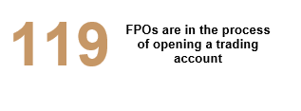
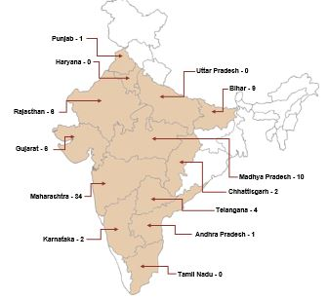
Connecting Farmers to Derivatives Market
Commodities traded on the Exchange platform since April 2016
Jeera
6 MT
Kapas
8 MT
Wheat
100 MT
Soy Meal
20 MT
RM Cake
20 MT
Castor
40 MT
Guar Seed
40 MT
Turmeric
40 MT
Cocud
40 MT
Barley
60 MT
RM Seed
360 MT
Soybean
7,790 MT
Maize
12,270 MT

Slide 16
Thank You

Slide 17
Hedging – Long Hedge
XYZ Soybeans processing company gets an order to supply 100 MT of Soybean Meal in December. XYZ can lock in price of the raw material (Soybean) by buying 100 MT (10 lots) in Soybean December expiry contract.
Spot price of Soybean in October is Rs.3000/Quintal
Soybeans December futures price is 3100/Quintal
After 2 months, in December
Spot Cost = 3000 + 1.5%*2 (Interest Cost) + 30 (maintenance cost) = Rs. 3120/qtl
On the day,
Spot price rises to Rs.3100
Futures price rises to Rs.3200
Actual cost of Soybeans: Rs.3000/qtl (Saved the interest and maintenance cost)
Gain in futures: 3200 - 3100 = Rs. 100/qtl
Loss in Spot: 3000 - 3100 = Rs.-100/qtl

Slide 18
Hedging – Short Hedge
ABC company is into trading of Soybeans, gets an order to supply 100 MT of Soybeans in December and price will be decided in June. ABC can lock in price of Soybeans by selling 100 MT (10 lots) in Soybeans December expiry contract.
Spot price of Soybeans in October is Rs.3000/Quintal
Soybeans December futures price is 3100/Quintal
After 2 months, in June
Spot Cost = 3000 + 1.5%*2 (Interest Cost) + 30 (maintenance cost) = Rs. 3120/qtl
On the day,
Spot decreases to Rs.2900
Futures decreases to Rs.3000
Actual sales price of Soybeans: Rs.3000/qtl (Saved the interest, maintenance cost and risk of fall in price)
Gain in futures: 3100 - 3000 = Rs. 100/qtl
Loss in Spot: 2900 - 3000 = Rs.-100/qtl

